Slide 1


Slide 2


Slide 3



From Legacy MVC to Modern MVC An ASP.NET Core Migration Path
Senior Content Developer @ Microsoft | @Scott_Addie

Slide 4
Agenda
Upgrade Paths
Assembly Portability
Dependency Injection
App Settings
Package Management
Bundling & Minification

Slide 5


You Are Here
ASP.NET 4.6
.NET Framework 4.6
Operating Systems
Editors VS 2015
Web Server IIS
Distribution OS
Notes:
ASP.NET introduced in 2002
Best candidate for ASP.NET Core = MVC or Web API

Slide 6


Determine Your Upgrade Path
ASP.NET Core 1.1
.NET Framework 4.7
.NET Core 1.1
net47
netcoreapp1.1
Operating Systems
Operating Systems
Editors VS 2015+, VS Code*
Editors VS 2015+, VS Code VS Code,
VS for Mac
Web Server IIS, Kestrel
Web Server IIS, Kestrel, HttpSys Nginx, Kestrel
Distribution OS
Distribution w/ or w/o App
* Debugging not currently supported
Notes:
.NET Core App Deployment Options
Framework-dependent
Self-contained
IIS reverse proxies HTTP to Kestrel
Kestrel doesn’t provide port 80/443 forwarding
Treat Kestrel just as your app server; not yet blessed as public-facing edge server
.NET Core not really a subset; has its own unique APIs & tooling
.NET Standard Library is new Base Class Library (BCL)
Popular APIs missing in .NET Core:
System.DirectoryServices
No LDAP / AD support
System.Drawing

Slide 7
The Value Proposition of .NET Core
X-plat
Open source
Everything is a dependency (cafeteria plan)
Broader container support
Cloud-optimized
Notes:
Containers
No machine-wide installation
App isolated from machine-level patches

Slide 8
.NET Core Tooling Considerations
VS Code, VS 2015 (Preview 2 Tooling)
VS Code, VS 2017, VS for Mac (RTM Tooling)
project.json
*.xproj
1-way
*.csproj
> dotnet migrate

Slide 9
Assembly Portability

Slide 10
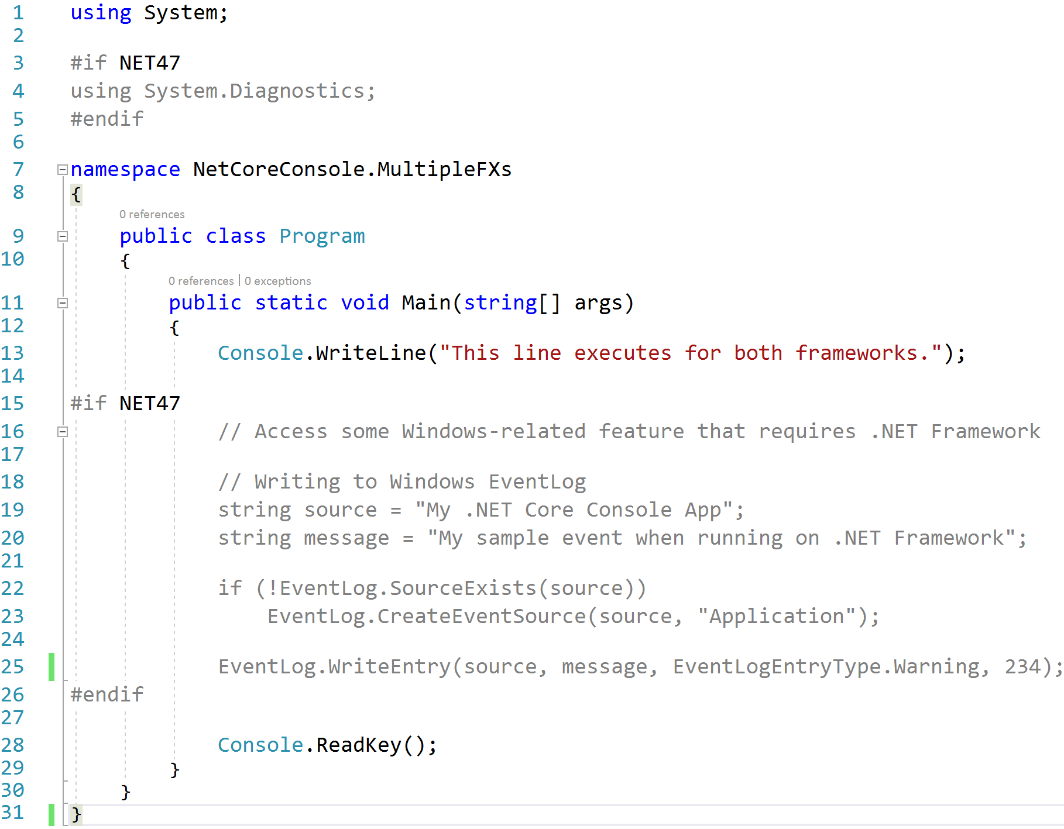
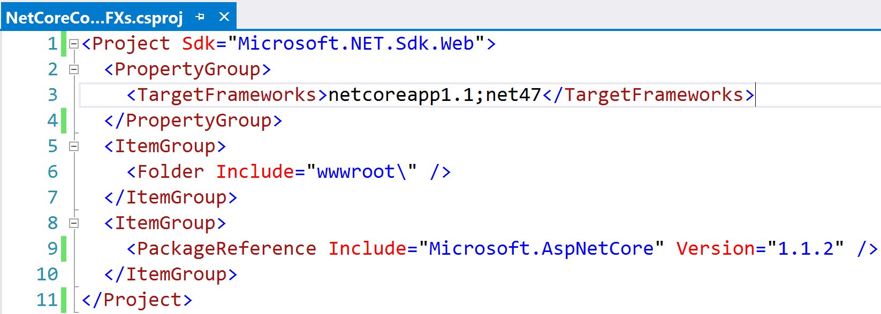
Precompiler Directives
Notes:
- 1st TFM is what VS runs against (for now)

Slide 11
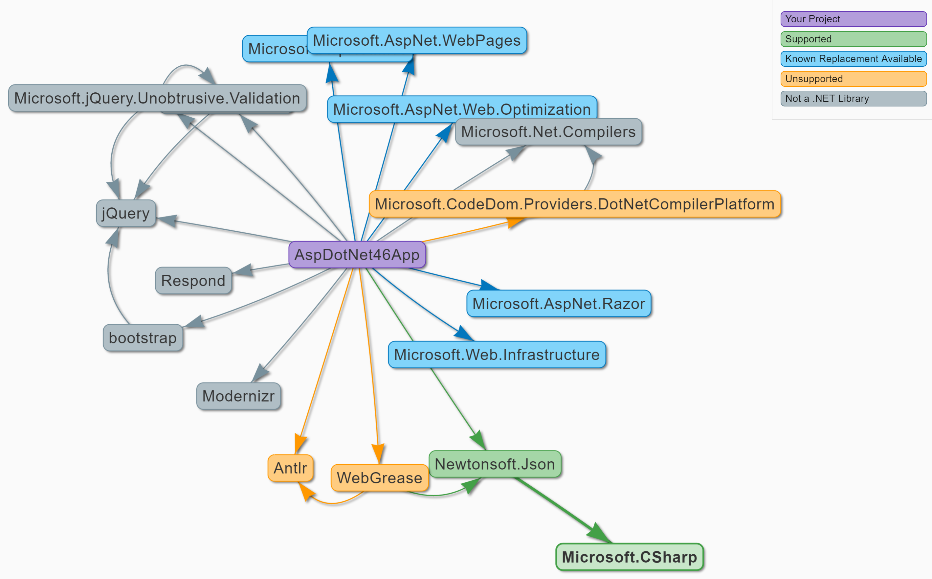
Portability Analyzers I Can Has .NET Core (https://icanhasdot.net/)
Notes:
VS 2017 CSPROJ projects NOT supported
NuGet & Paket supported

Slide 12
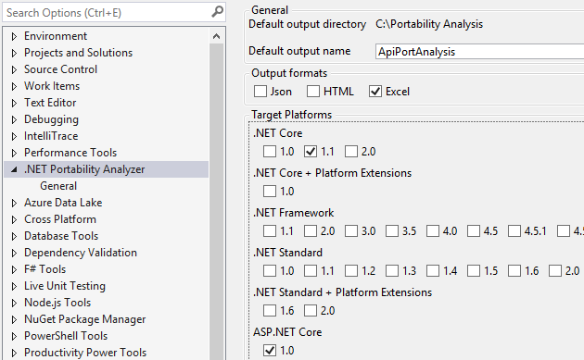
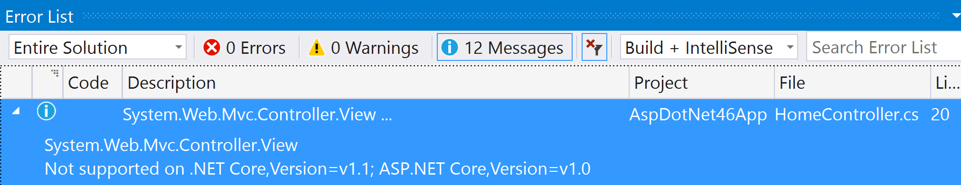
Portability Analyzers .NET Portability Analyzer (http://bit.ly/2llzOPS)
Notes:
Target .NET Framework 4.6.1+ as long as possible before switching to .NET Core
Missing APIs available in .NET 4.6.1
.NET Standard 2.0 introduces ~20k new APIs (e.g., DataTable, DataSet)
.NET Core 2.0 implements .NET Standard 2.0
- ~5k more APIs in .NET Core 2.0

Slide 13

.NET Portability Analyzer 3 Options
.NET Portability Analyzer
Console Application
Visual Studio Extension
.NET Core Application

Slide 14




.NET Portability Analyzer How It Works
Assemblies
Assemblies
ApiPort VS Extension
Portability Service

Slide 15
Dependency Injection

Slide 16
Native IoC Container Constructor Injection
Startup.cs
public void ConfigureServices(IServiceCollection sc) { sc.AddTransient<IAttendeeService, AttendeeService>(); // Add framework services. sc.AddMvc(); }
AttendeesController.cs
public class AttendeesController : Controller { private readonly IAttendeeService _attendeeSvc; public AttendeesController( IAttendeeService attendeeSvc) { _attendeeSvc = attendeeSvc; }

Slide 17
Autofac Constructor Injection
AutofacModule.cs
public class AutofacModule : Module { protected override void Load(ContainerBuilder cb) { cb.RegisterType<AttendeeService>() .As<IAttendeeService>(); } }
Startup.cs
public IServiceProvider ConfigureServices(IServiceCollection sc) { // Add framework services. sc.AddMvc(); var containerBuilder = new ContainerBuilder(); containerBuilder.RegisterModule<AutofacModule>(); containerBuilder.Populate(sc); var container = containerBuilder.Build(); return container.Resolve<IServiceProvider>(); }
AttendeesController.cs
public class AttendeesController : Controller { private readonly IAttendeeService _attendeeSvc; public AttendeesController( IAttendeeService attendeeSvc) { _attendeeSvc = attendeeSvc; }

Slide 18
3rd Party DI Frameworks
More feature rich
Extensible lifetimes (per thread, per resolve cycle, etc.)
Auto wiring of types in assembly
Resolve Lazy<T> instances of registered types
Recommendation:
Native IoC for greenfield development
3rd party IoC to migrate existing investment

Slide 19
App Settings

Slide 20
XML is Abandoned for JSON
web.config
appsettings.json
<configuration> <appSettings> <add key="webpages:Version" value="3.0.0.0" /> <add key="webpages:Enabled" value="false" /> <add key="ClientValidationEnabled" value="true" /> <add key="UnobtrusiveJavaScriptEnabled" value="true" /> <add key="AttendeeInfo:FirstName" value="Scott" /> <add key="AttendeeInfo:LastName" value="Addie" /> <add key="AttendeeInfo:IsSpeaker" value="true" /> </appSettings>
{ "Logging": { "IncludeScopes": false, "LogLevel": { "Default": "Debug", "System": "Information", "Microsoft": "Information" } }, "AttendeeInfo": { "FirstName": "Scott", "LastName": "Addie", "IsSpeaker": true } }

Slide 21
Retrieving App Settings Strongly-typed IOptions<T>
Startup.cs
public void ConfigureServices( IServiceCollection sc) { sc.AddOptions(); sc.Configure<Attendee>(Configuration .GetSection("AttendeeInfo")); }
appsettings.json
Attendee.cs
{ "AttendeeInfo": { "FirstName": "Scott", "LastName": "Addie", "IsSpeaker": true } }
public class Attendee { public string FirstName {get; set;} public string LastName {get; set;} public bool IsSpeaker {get; set;} }
AttendeesController.cs
Map
public class AttendeesController : Controller { private readonly Attendee _attendee; public AttendeesController( IOptions<Attendee> attendee) { _attendee = attendee.Value; }
Inject
AttendeesController.cs
var firstName = _attendee.FirstName;
Retrieve

Slide 22
Retrieving App Settings IConfiguration.GetValue
Startup.cs
public void ConfigureServices( IServiceCollection sc) { sc.AddSingleton<IConfiguration>( Configuration); }
appsettings.json
AttendeesController.cs
{ "AttendeeInfo": { "FirstName": "Scott", "LastName": "Addie", "IsSpeaker": true } }
public class AttendeesController : Controller { private readonly IConfiguration _config; public AttendeesController( IConfiguration config) { _config = config; }
Inject
Retrieve
AttendeesController.cs
var firstName = _config.GetValue<string>( "AttendeeInfo:FirstName");

Slide 23
Package Management

Slide 24
NuGet Changes
packages.config is dead
VS 2015 Update 1+ ← project.json
VS 2017 ← *.csproj w/ <PackageReference />
OLD NEW
<.sln_folder>\packages %USERPROFILE%\.nuget\packages
Notes:
- repositories.config goes away

Slide 25
NuGet Centralized Packages Repository
NuGet Cache
ASP.NET Core App
ASP.NET Core App
ASP.NET Core App
Microsoft.AspNetCore.Mvc
Microsoft.EntityFrameworkCore
Newtonsoft.Json
Notes:
Assume this is the CI server
Per user package cache (service account runs builds)

Slide 26
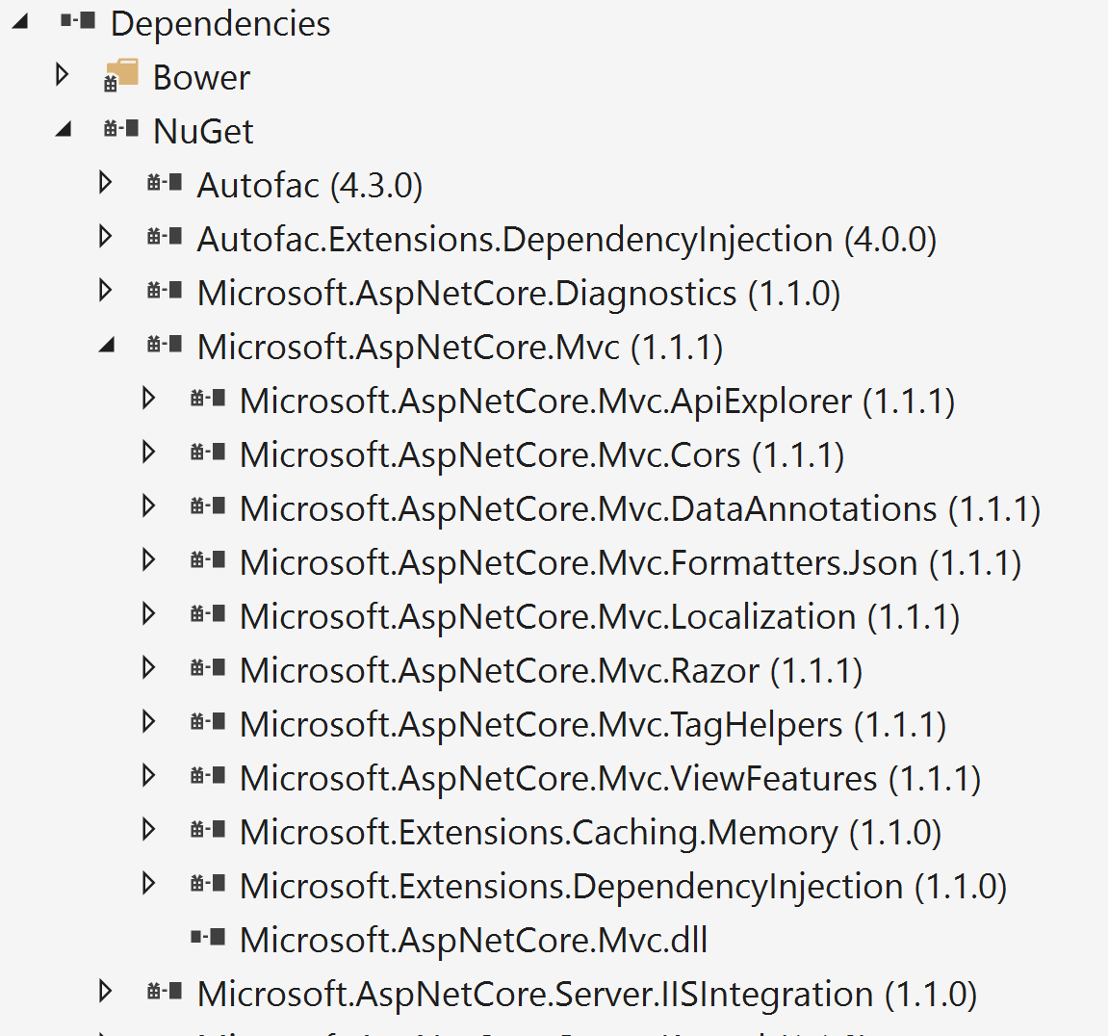
NuGet Transitive References
<project_name>.csproj
<ItemGroup> <PackageReference Include="Microsoft.AspNetCore.Mvc" Version="1.1.1" />

Slide 27


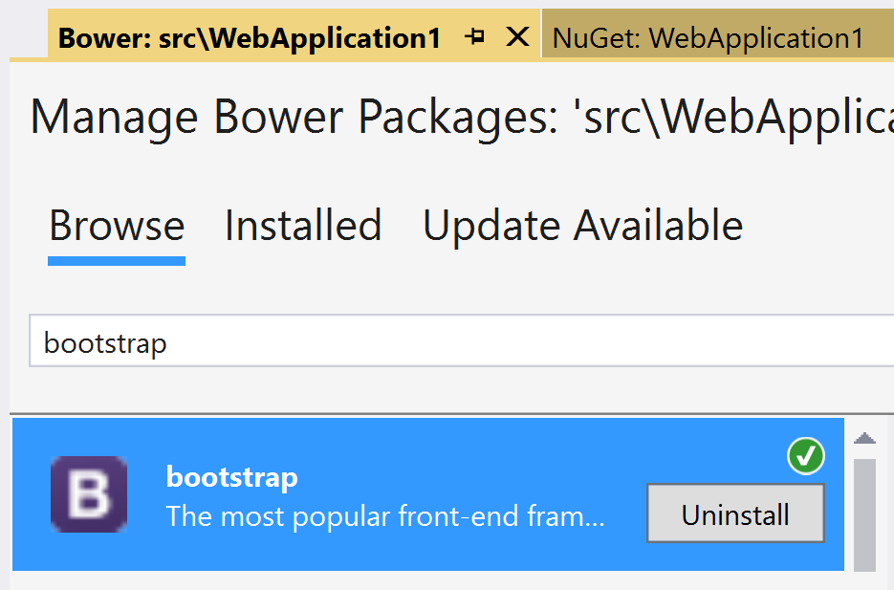
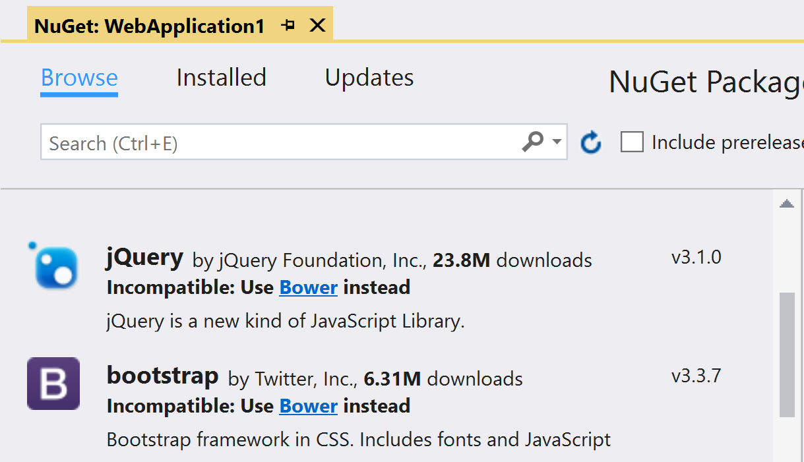
Bower Static Asset Acquisition
Manage NuGet Packages
Manage Bower Packages
Notes:
- Content files not supported in ASP.NET Core projects

Slide 28
Bundling & Minification

Slide 29
A Look at Where We’ve Been
Microsoft.AspNet.Web.Optimization
Grunt
Gulp
ASP.NET 4.5
NuGet
C# or VB.NET
On-the-fly processing by web server
ASP.NET 5 Beta
npm
JavaScript
Process before deploying
ASP.NET Core 1.0 RC
npm
JavaScript
Process before deploying

Slide 30

The Way Forward
bundleconfig.json
[ { "outputFileName": "wwwroot/css/site.min.css", "inputFiles": [ "wwwroot/css/site.css" ] }, { "outputFileName": "wwwroot/js/site.min.js", "inputFiles": [ "wwwroot/js/site.js" ], "minify": { "enabled": true, "renameLocals": true }, "sourceMap": false } ]
BundlerMinifier.Core
ASP.NET Core 1.0 RTM
NuGet
JSON
Process before deploying
Notes:
Bundler & Minifier added to Preview 2 Tooling
Uses a .NET Core port of AjaxMin for minification, called NUglify

Slide 31
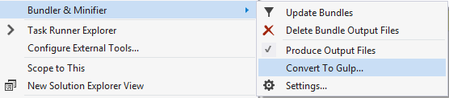
…but Gulp still has its place
Bundler & Minifier extension
Reserve for complex workflows
Notes:
Reasons for Gulp Replacement:
Publishing was taking a long time w/ Gulp & npm
npm had to install all of its packages
There were already enough new concepts in ASP.NET Core
Many customers don’t like having node_modules in their project
~1,500 files in node_modules folder
File ➔ New ➔ Project was quicker w/o npm

Slide 32

A Supplementary Resource
Telerik Developer Network article
Migration to ASP.NET Core: Considerations and Strategies
http://bit.ly/2lHxgyb

Slide 33


Slide 34





Thank you!
@Scott_Addie
scottaddie.com
github.com/scottaddie
/DotNetCoreSampleApp
/slide-decks

